Slide 1
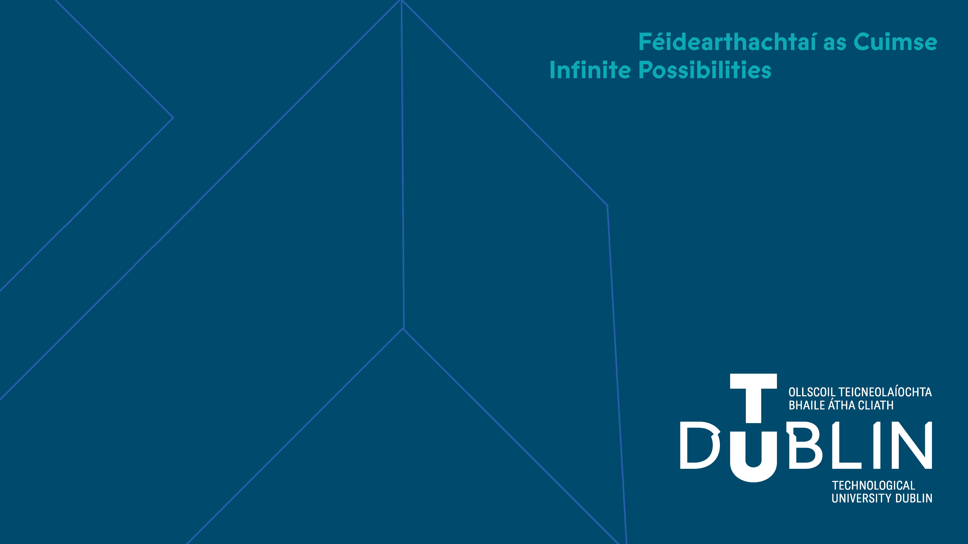
Week 10 11
Advanced architectures
Fundamentals of IoT
Dr. Eoin Rogers (eoin.rogers@tudublin.ie)

Slide 2
Lesson Outline
Now that we’ve seen more complex IoT systems, it’s useful to think about what the architecture of such systems might look like!
We’ll examine the architectures of some real IoT systems
We’ll also look at protocol buffers, a form of data encoding developed by Google

Slide 3
Architectures
Can anyone name the three architectural styles?

Slide 4
Architectural styles
Device-to-cloud
Device-to-gateway
Device-to-device

Slide 5
Three tier architecture of IoT devices
Tier 1 – Edge devices
Tier 2 – Gateway devices
Tier 3 – Cloud systems

Slide 6
Case studies
Three examples of IoT systems

Slide 7
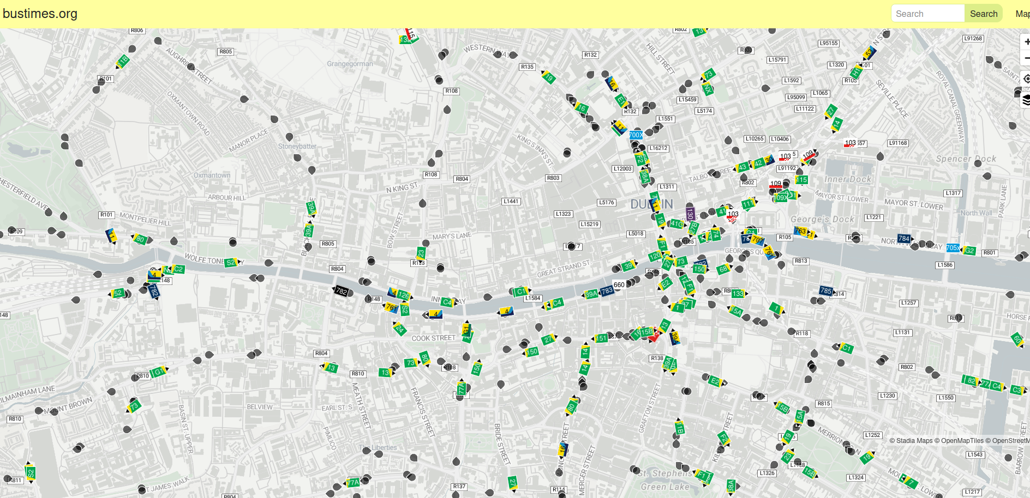
Bus Times

Slide 8
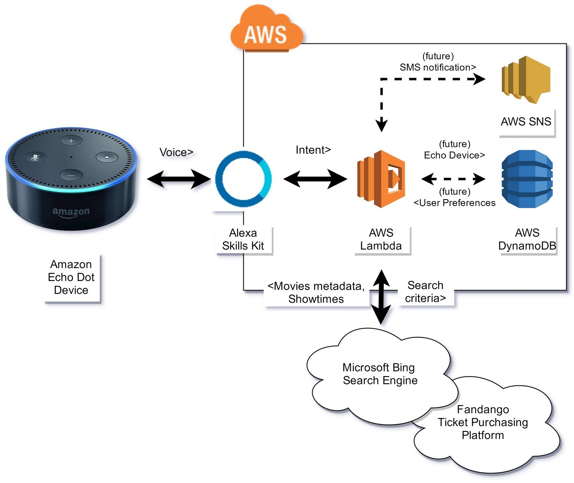
Amazon Echo/Alexa

Slide 9
Alexa Skills Kit (ASK)
This is what you use to develop new Alexa skills
Users can add them to an Echo they own via an online store
The skills then run on an AWS Lambda service

Slide 10
Recognising speech commands
Internally, the system uses a neural net to convert the speech into text, which is matched against sample utterences that should trigger the skill
Sample utterences can contain slots (variables you want to show up in the intent containing a word of phrase of interest)
These can then be converted to data structures called intents

Slide 11
The AbstractRequestHandler class
You can write code in Python or JS to respond to an intent
The code should derive from a class called AbstractRequestHandler, and you should override two methods to implement the functionality:
  can_handle() -- Returns true iff your code can handle this intent
  handle() -- Which will actually compute the response

Slide 12
Our IoT temperature system
What would the architecture look like for this system?
How would you document it in a diagram?

Slide 13
Protocol buffers
An efficient system for sending data over the internet

Slide 14
Protocol buffers overview
Developed by Google in 2001, open sourced in 2008
Allows you to define a schema and encode/decode messages in it into a binary data format that is small and low bandwidth
A protocol buffer compiler (protoc) auto-generates the code for this for you: there is no need to write low-level bit manipulation code yourself...

Slide 15
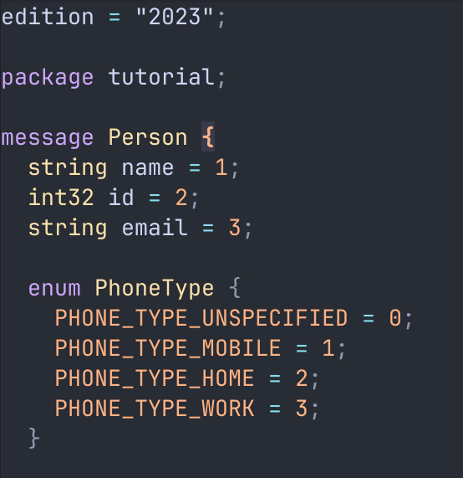
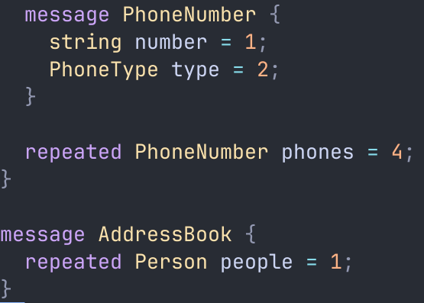
Protocol buffer schemas

Slide 16
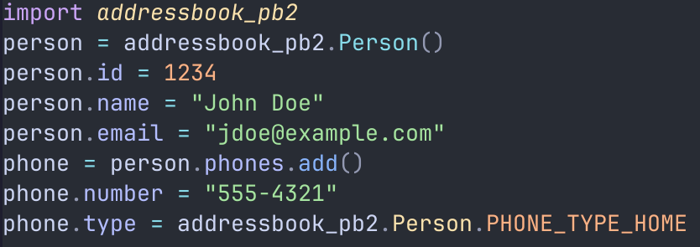
Using the generated code in Python

Slide 17
gRPC
Protobufs are also the basis of Google’s Remote Procedure Call protocol (gRPC), which is widely used in industry
The normal protobuf language allows you to specify procedures in the form of function signatures
This is used to generate both client and server-side code. The server code is then modified to implement the desired behaviour

Slide 18
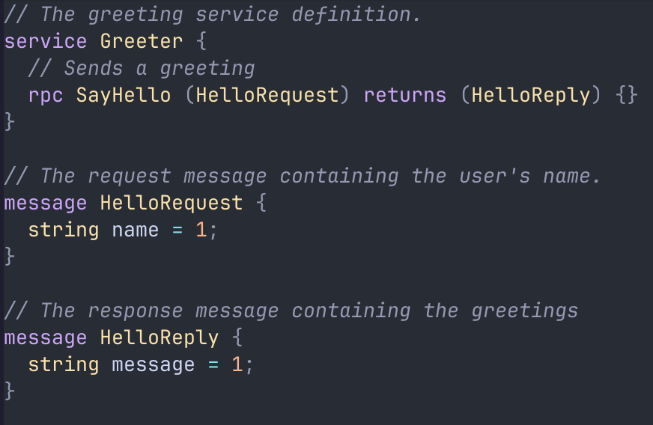
gRPC example

Slide 19
Summary
Reviewed the architectural styles common IoT systems
Introduced the idea of three tiered systems, which is a common way of thinking about IoT systems
Discussed the architecture of three IoT systems, and described how you might document and communicate this information
Provided an introduction to Google’s protobuf system

Slide 20
<number>
That’s all for this week
Thanks for your attention!

